Slide 1

Making the Transition to Conflict-free Case Management in Alaska, Colorado, and Wyoming: Lessons from the Front Lines
Presentation Given at the 2015 National HCBS Conference

Slide 2
Speakers
HCBS Strategies:
  Steve Lutzky, President
Colorado Department of Health Care Policy and Financing:
  Jed Ziegenhagen, Director for the Office of Community Living
  Brittani Trujillo, Case Management Services Coordinator
Alaska Department of Health and Social Services:
  Duane Mayes, Director Senior and Disabilities Services
Wyoming Department of Health:
  Chris Newman, Behavioral Health Division Senior Administrator
  Joe Simpson, Developmental Disabilities Section Administrator
  Kathy Escobedo, Provider Support Unit Manager

Slide 3
Conflict of Interest Requirements in the HCBS Rule for 1915(c) waivers
42 FR §441.301 (c)(1)(vi)
Providers of HCBS for the individual, or those who have an interest in or are employed by a provider of HCBS for the individual, must not provide case management or develop the person-centered service plan,
except when the State demonstrates that the only willing and qualified entity to provide case management and/or develop person-centered service plans in a geographic area also provides HCBS.
In these cases, the State must devise conflict of interest protections including separation of entity and provider functions within provider entities, which must be approved by CMS.
Notes:
Will be developing a plan that includes employment supports, assigning a waiver program that does not offer employment supports – many states will be lacking the needed infrastructure to make this possible.
Adding in a provision that says all of the services must be offered in a manner that is consistent with the person centered plan.
In terms of CFCM language:
Individual based
Only exception is if there is no other provider to
Questions: Initial assessment, care plan, case management, and the services
Is it permissible for waiver case management or case management agencies be separated for the Person Centered Planning? The ongoing care management person is doing the PCS Plan. Some states have separated the ongoing case management from the service or support plan. Some states have put initial assessment and care plan into one step and turn over to a care manager

Slide 4
Other Considerations
Unlike settings, no transition, became effective 3/17/14
  CMS appears to be drawing a line at the waiver renewal, but the line could change
Rules address“case management”
  Does not explicitly discuss implications of whether case management is paid as an administrative cost or with non-federal dollars.
  CMS has made it clear that if the individual is receiving funds under one of the authorities, the rules apply to the person and all of the supports they receive. State only dollars will not buy an exemption.

Slide 5
Where to draw the line between CM and service provision
Need to delineate:
  Support plan vs. implementation plan.
  Monitoring requirements for case manager vs. service provider.
Handling transition from current to the compliant system

Slide 6
Selection of States for this Panel
We conducted interviews with multiple states to assist Alaska in developing a plan, which they are implementing (during)
Colorado provides an example of a state engaging in an extensive stakeholder input process (before)
Wyoming provides lessons for a state that has completed the transition (after)

Slide 7
Conflict Free Case Management
Colorado's Transition
Brittani Trujillo and Jed Ziegenhagen

Slide 8
HCPF Mission

Slide 9
Implementing Conflict Free Case Management in Colorado
Colorado’s Current Case Management System Structure and Conflicts
Challenges Faced While Changing the System
Approach to Changing the System
Actual or Potential Benefits/Drawbacks
Lessons for Other States

Slide 10
Colorado’s Current Case Management System Structure and Conflicts
Community Centered Boards (CCB) and Single Entry Points (SEP)
Administrative and Targeted Case Management
Providers of HCBS waiver services
Past attempts to address conflict of interest
  University of Southern Maine, 2007
  Conflict of Interest Task Force, 2010
  Conflict Free Case Management (CFCM) Task Group, 2014
  Community Living Advisory Group, 2014

Slide 11
Challenges Faced While Changing the System
Services and case management for individuals with intellectual and/or developmental disabilities (I/DD) in place prior to waivers and Medicaid funding
  CCBs don’t just provide case management
    The “go-to” place for all things IDD
    Organized Health Care Delivery System (OHCDS)
    State Funded Programs

Slide 12
Challenges Faced While Changing the System
Waiver Redesign for I/DD adult waivers
  HB15-1318
  Redesigning services
Statute Changes
  CCBs designated by statute to provide CM for individuals with I/DD

Slide 13
Colorado’s Approach to Changing the System
CFCM Task Group 2014
  Met from February-October
  Submitted report with three recommendations:
    Option 1: Complete separation of case management from direct service provision
    Option 2: An agency can provide both case management and direct services, but not to the same individual
    Option 3: An agency can provide both case management and direct services to the same individual, as long as there is a robust, informed consent, opt-out option
  The Department released the report for public comment February 2015
  Upon receipt of all public comment, the Department responded to the report, May 2015

Slide 14
Colorado’s Approach to Changing the System
Colorado contracted with Navigant Consulting, Inc.
  Financial Analysis of all CCBs
  Desk Reviews
  On-site visits
Colorado contracted with Public Knowledge
  Conduct bi-weekly to monthly meetings with the Department and CCB Executive Directors
  Provide a report with recommendations for an implementation plan for CFCM

Slide 15
Actual or Potential Benefits
Benefits
  Individuals will be afforded choice in case management agency and in direct services
  Real or perceived conflict of interest will no longer exist
  The way in which case management is delivered and reimbursed can be redesigned
    Individuals can receive the level of case management they need
    Case management can be reimbursed accordingly
  Increase in provider capacity

Slide 16
Actual or Potential Drawbacks
Drawbacks
  Supporting people (individuals receiving services, CCB employees, community members) through the change
  Providing a stable transition for all people involved, without eliminating the other essential CCB functions
  None of the CCBs operate in exactly the same manner
  Some individuals and families have a longstanding relationship with their case manager, case management agency, and/or direct service provider

Slide 17
Lessons for Other States
Engage the community from the beginning
Listen
Establish a communication plan
Listen
Establish a framework
Listen
Provide plenty of opportunity for feedback
Listen

Slide 18
Questions or Comments?

Slide 19
Contact Information
Brittani Trujillo
Case Management Services Coordinator
Brittani.Trujillo@state.co.us
Jed Ziegenhagen
Director, Office of Community Living
Jed.Ziegenhagen@state.co.us

Slide 20
Thank You!

Slide 21

Conflict free case management: New rules, new directions
CMS REGULATIONS EFFECTIVE MARCH 17, 2014

Slide 22
What % of recipients receive CFCM currently?

Slide 23
What % of recipients receive CFCM currently?
68% of ALI recipients
41% of APDD recipients

Slide 24
What % of recipients receive CFCM currently?
17% IDD recipients
19% CCMC recipients

Slide 25

What we’ve done so far
Convened a working group of DHSS, Trust and provider stakeholders
Made decisions to “redesign the system”
Hired consultants to facilitate a planning process
Received “Conflict-Free Case Management System Design” report from consultants containing four options for system design:

Slide 26
Proposed approaches to CFCM
Option 1: Current system with modifications – separation of case management and service delivery
Option 2: State-designated, single case management agency per region
Option 3: State-designated “administrative support only” agencies
Option 4: Multiple agencies that provide case management and administrative support

Slide 27
The direction we’re going
Option 1: Current system with modifications – separation of case management and service delivery
Option 4: Multiple agencies that provide case management and administrative support
  Promotes choice and quality
  Administratively feasible
  Builds on current system

Slide 28
Identified Tasks
  Determine current capacity for CFCM in all geographical areas of the state

Slide 29
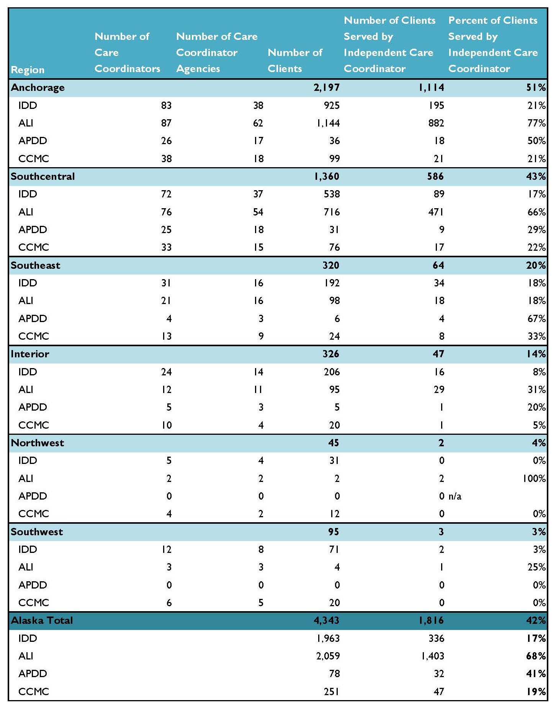
Waiver Recipients Currently Served by Conflict-Free care coordinators,
by Region and Waiver Type*
*Regional totals for care coordinators and care coordination agencies
are not available as unduplicated counts.

Slide 30
Identified Tasks
  Identify places where there is only one willing and qualified agency to provide both case management and HCBS
  By “geographical area”
    Census area? Region? City? Tribal health region?
  Verification?

Slide 31
Identified Tasks
  Develop a method to stabilize areas with a “sole-source” provider
    Time-limited “designation”?
    “Open enrollment” periods?

Slide 32
Identified Tasks
Establish strategies to mitigate conflict of interest when “sole-source” agencies are allowed to offer both case management and HCBS
    Disclosure
    “Firewalls”

Slide 33
Identified Tasks
Continue to ensure recipient health, safety and welfare
  Quality standards for CFCM
  Excellent provider policy, certification, and compliance support
  CFCM capacity-building
  Ensure adequate training resources
  Negotiate acuity-based rates

Slide 34


Wyoming’s Conflict Free Case Management
Roll-Out Process
Notes:
We have our contact information listed at the end of this presentation in case you have any questions for us.

Slide 35
Case Management Structure Prior to Change
Wyoming certifies all providers as independent contractors
Providers are certified as individuals or agencies
Both could provide case management and other waiver services they were qualified for to anyone on their caseload
Notes:
Instead of contracting with providers, Wyoming certifies all waiver providers. Providers go through an initial certification process and recertification, which may be annual or as long as 3 years depending on what services a provider is certified in.
In Wyoming’s previous case management system, all providers of waiver services could also provide case management as long as they met the definition for the service.
To clarify: Wyoming had many provider agencies who employed case managers and the agency could also provide all other waiver services that a participant needed.
Wyoming also had independent case managers not employed by an agency. They could also provide case management to a participant and any other waiver services as long as they met applicable requirements.

Slide 36
Issues with Model
Case managers and case manager agencies were essentially monitoring themselves
No real advocacy
  Case managers hired by agencies were often forced with the dilemma between advocating or keeping their job
  Individual case managers who were self-employed were often promoting their own waiver services
Notes:
Wyoming received many complaints from case managers who were employed by an agency regarding the difficulty with truly advocating for a participant who wished to seek out other providers of waiver services. They had to consider the risk of possibly losing their job. Often times, case managers were being utilized by the agency for purposes that were beyond the scope of case management. For example: filling in for direct care staff, i.e.; providing waiver services, taking participants to medical appointments, all of which potentially took them away from their duties as a case manager.
Wyoming also heard from guardians that case managers weren’t always providing all options available to participants regarding other providers of services. With case managers that provided both case management and other waiver services, trying to balance all the work entailed was difficult. In some cases the participant received services from either the Case Manager or the case manager’s family and they were the only service providers on the plan which led to conflicts.

Slide 37
Challenges in Trying to Change the System
We received many concerns from individual case managers, agencies that employed case managers, guardians, and participants
Notes:
Wyoming heard loudly from case managers, agencies, guardians, and participants that they did not want to change.
Participants and/or their guardians did not want to lose their case manager and did not want to find either a new case manager or another provider to provide waiver services.

Slide 38
Concerns Included:
Loss of income for the case manager
Loss of either a case manager or a provider for the participant and guardian
Loss of income from case management services for agencies that employed case managers
Loss of benefits for case managers employed by agencies that had built up retirement and/or insurance
Loss of case managers
All of the above led to legislative concerns
Notes:
Case managers that provided both case management and waiver services were concerned about potential loss of income since they would have to choose between either providing one or the other and not both.
Guardian’s and participants were very concerned that they were essentially being forced to make very difficult choices to either choose a new case manager or chose another waiver provider. They were also challenged by the fact that they were going to either lose their case manager who they had known for years and had established good relationships with or lose their waiver provider who was providing good services to their ward.
For agencies that employed case managers, they were faced with losing this source of income. In Wyoming, case management was the 4th largest cost driver of the waivers.
Most agency case managers had benefits that they were going to potentially face losing such as health benefits and some had invested decades of time towards a retirement system which would not longer be available.
Those case managers had to consider what it would mean to be self-employed, the health benefits would be more costly and they would need to establish their own retirement system.
Loss of case managers was a huge concern for all, especially the loss of case managers in extremely rural areas of the state.

Slide 39
Approach
Wyoming was already looking into changes to the case management system, which was part of a legislative mandated waiver re-design of the entire Medicaid Waiver System that included waiver case management services
Notes:
In 2013, the Wyoming State Legislature mandated that the entire Medicaid waiver system be redesigned. Included in the legislative act was the provision that the case management system be re-designed to become conflict free.

Slide 40
Research and Decision Making Process
Wyoming wanted to increase case management qualifications along with exploring available case management models
Contracted with National Association of State Directors of Developmental Disabilities Services (NASDDDS)
Consultant came to Wyoming and met with Wyoming Department of Health (WDH) leaders to describe different approved case management models
Notes:
As part re-designing the case management system, the Division also felt that it was time to increase the qualifications of case managers. The previous model allowed case managers with a minimum of an Associates Degree or at least 48 college credits to qualify as a case manager. There was nothing required regarding credit hours to come from an accredited college or university, and the Division rules did not specify what the Associates Degree needed to be in.
Wyoming wanted to explore all available case management models to ensure the best model was used and to get started with this, Wyoming reached out to NASDDDS.
The Division had a formal meeting with the NASDDDS contact and went over all available case management models which included not only waiver case management, but target case management available on the Medicaid State Plan and Administrative case management.

Slide 41
Research Continued
Stakeholder teams were developed
Conducted research on other states
Consulted with the contractor from NASDDDS
Teams met weekly and discussed:
  case management models in the states researched
  how case management was billed; and
  qualifications for case managers in other states
Draft recommendations were developed and presented to Senior Leadership of WDH
Notes:
Next step after that meeting:
A stakeholder team was developed which included individual case managers, representatives from case management agencies that also provided other waiver services, and Behavioral Health Division (BHD) staff.
Each member of the team was assigned a specific research task to complete with several members researching case management models and qualifications of other states.
The team also looked into how case management was billed and the rate paid in a variety of states. Wyoming at that time was billing on a monthly basis with a minimum of 2 hours per month per participant in order to bill. Our monthly rate was $268 for the 2 hours minimum.
The Division continued consulting with NASDDDS.

Slide 42
Research Continued
The senior leadership team met to discuss recommendations of the case management team
Final decisions were made regarding case management qualifications and the model to be used
Notes:
.

Slide 43
Process to Implementation
Developed draft case management model
Received guidance on proposed model from WDH attorney and Attorney General
Proposals were met with a great deal of negative response and resulted in legislative push back
Senior leaders spoke to legislators during the legislative session
Notes:
The internal team developed a draft case management model that listed the updated case management qualifications, requirements for course work, and addressed all conflicts.
There was allowance for current case managers to be grandfathered in as long as they met certain key coursework requirements.
The Division consulted with our representative from the Attorney General’s office, as well as, a WDH attorney to ensure we had corrected identified what a conflict was and what the Division would not accept.
There was a great deal of feedback being provided to legislators from their constituents and the WDH senior leads consulted with many legislators to discuss the issues.

Slide 44
Process to Implementation
Around the same time the Wyoming Legislature was meeting, CMS made conflict free case management a requirement
Legislature made final decisions on the model and case management qualifications
Notes:
Our NASDDDS consultant made the Division aware that CMS had made conflict free case management a requirement during the same time that the legislature was meeting on the issues. Some legislators contacted the CMS office in Washington to confirm the requirements.
Once confirmed, the legislature reviewed the proposed conflict free model and the increased qualifications and made final decisions.
Concessions were made to allow case managers to still provide other waiver services as long as they were not also providing case management to the same participant.
Current case managements were allowed to be grandfathered in as long as they had an Associate degrees and for those that did not have an Associates Degree, they were given 36 months to complete additional coursework if needed.
We allowed both case management agencies and sole proprietorship.

Slide 45
Process to Implementation
Created internal BHD staff team who developed process for reviewing qualifications, grandfathering in for some case managers with the expectation of increased college coursework
BHD staff team developed a full implementation roll-out process which started July 1, 2014
Notes:
Once we had final legislation in place, we created a conflict-free case management team which was comprised of BHD staff who had all provided some type of case management services in the past.
That team developed the a conflict-free case management application which we required all case management agencies to complete, reviewing case management qualifications, and confirmation that no conflicts existed.
All relevant documents were ready to go starting July 1, 2014 and the BHD internal team began the review of applications and qualifications.

Slide 46
Implementation
Full roll-out was completed on July 1, 2015, at which time the entire case management system was conflict free
Notes:
The BHD team created a google folder where all documents were scanned and uploaded. This enabled anyone that the folder was shared with to have access to all documents that had been received.
The BHD team sent out provider e-mails and took part in monthly provider calls with reminders of the timeline.
The final timeline was set for July 1st and we made it with a extensive encouragement to case managers to get documents sent in.

Slide 47
Actual or Potential Benefits/Drawbacks from Changes
Actual Benefits
Improved advocacy for participants
Improved choices in services that best meet needs and wishes of participants (person-centered planning)
Increased independence for participants
Positive feedback received from the case managers on aspects of the change
Notes:
A lot of case managers have commented on how their advocacy for participants has significantly improved.
The Division has seen where there have been a great deal of improvement in providing choice to participants and guardians.
Case managers have also informed the Division of increased independence.
The Division has received a lot of positive feedback regarding the changes from case managers, waiver providers and participants and guardians.
Some of this feedback has come from people who were the most opposed when the model was introduced. They have stated that they did not realize how conflicted they truly were until they moved into a conflict free model.

Slide 48
Actual Drawbacks
Loss of benefit packages for case managers that left agencies
Some difficulty with communication for case managers who are no longer employed with agencies
Agencies are unhappy that teams are discussing other available waiver service options and/or other providers
Notes:
Some case managers previously employed by agencies did lose their employee benefit packages. Some newly created agencies had support from their local legislators to find ways to create retirement and health insurance packages.
Many large provider organizations have struggled as they used to control the entire budget of the participant. Some have evolved with the change in case management and are doing well while others are having a very hard time letting go of control of having all the decision making power.

Slide 49
Lessons for Other States
Ensure there are legislators on the stakeholder team
Try to meet with various legislators to discuss process, proposal, options, and concerns
Stick to the model that is developed to ensure its integrity
Anticipate negative comments and requests to allow exceptions
Notes:
Legislators are key to this process and constituents were very vocal regarding all the negative aspects of going conflict free. Most constituents thought it was an option not a requirement even after CMS made it a requirement.
There were quite a few case managers who called to request an exception since going conflict free meant they had to make a choice between providing case management services or providing waiver services to the same participant. This was hard for guardians and participants to choose; however, sticking to the model really ensured consistency and integrity of the conflict free case management system.
Do anticipate negative comments and requests to make exceptions. Sticking to the model really ensured consistency and integrity of the conflict free case management system.
The staff working on the project always referred to the model and often reviewed it with constituents which helped give them something to refer to as well as ensured the model was always followed.

Slide 50
Thank You
Chris Newman, M.H.A.,Senior Administrator, Behavioral Health Division, chris.newman@wyo.gov
Joe Simpson, M.S., Ed.S., Developmental Disabilities Administrator, Behavioral Health Division, joe.simpson@wyo.gov
Kathy Escobedo, M.S., Provider Support Manager, Behavioral Health Division, kathy.escobedo@wyo.gov
And Special Thanks To:
Jennifer Adams, Provider Support Specialist
Sheila Thomalla, Provider Support Specialist

Slide 51

Questions

